Slide 1
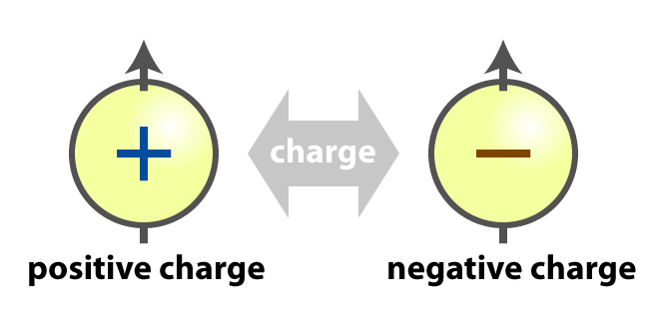

Electrostatics
NCERT

Slide 2
Electric Charge
Glass rods rubbed with wool or silk Cloth
Glass Rod – +ve charge
Wool or Silk Cloth – -ve charge
Plastic rods rubbed with cat’s fur
Plastic Rod – -ve charge
Cat’s Fur – +ve charge

Slide 3
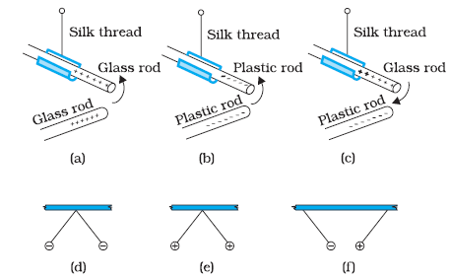
Electric Charge
Rods and pith balls: like charges repel and unlike charges attract each other.

Slide 4
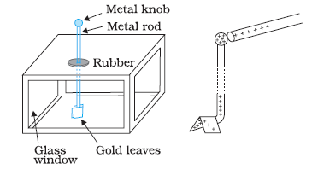
Electric Charge
Gold-leaf electroscope

Slide 5
Conductors and Insulators
Conductors
readily allow passage of electricity through them
They have electric charges (electrons) that are comparatively free to move inside the material.
Metals, human and animal bodies and earth are conductors.
Insulators
offer high resistance to the passage of electricity through them
non-metals like glass,porcelain, plastic, nylon, wood etc
Semiconductors
offer resistance to the movement of charges which is intermediate between the conductors and insulators.

Slide 6
Methods of Charging
By Rubbing
By Contact
By Induction

Slide 7
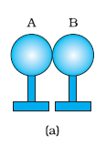
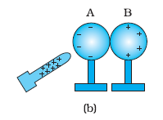
Charging by Induction
Bring two metal spheres, A and B, supported on insulating stands, in contact .
Bring a positively charged rod near one of the spheres, say A, taking care that it does not touch the sphere. The free electrons in the spheres are attracted towards the rod.

Slide 8
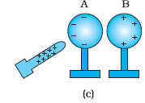
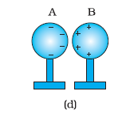
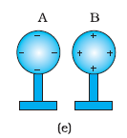
Charging by Induction (contd.)
Separate the spheres by a small distance while the glass rod is still held near sphere A. The two spheres are found to be oppositely charged and attract each other.
Remove the rod. The charges on spheres rearrange themselves as shown in Fig.
Now, separate the spheres quite apart. The charges on them get uniformly distributed over them, as shown in Fig).

Slide 9
Problem – Charging (NCERT)
Q: How can you charge a metal sphere positively without touching it?

Slide 10
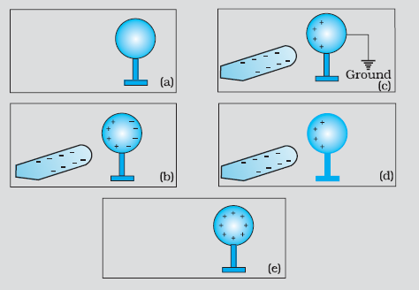
Problem – Charging(Contd.)
Q: How can you charge a metal sphere positively without touching it?
Figure (a) shows an uncharged metallic sphere on an insulating metal stand.
Bring a negatively charged rod close to the metallic sphere, as shown in Fig.(b).
As the rod is brought close to the sphere, the free electrons in the sphere move away due to repulsion and start piling up at the farther end. Connect the sphere to the ground by a conducting wire. The electrons will flow to the ground while the positive charges at the near end will remain held there due to the attractive force of the negative charges on the rod, as shown in Fig. (c).
Disconnect the sphere from the ground. The positive charge continues to be held at the near end [Fig. (d)].
Remove the electrified rod. The positive charge will spread uniformly over the sphere as shown in Fig. (e).

Slide 11
BASIC PROPERTIES OF ELECTRIC CHARGE
Additivity of charges
n charges q₁, q₂, q₃, …, q_{n ,} total charge of the system is q₁ + q₂ + q₃ + … + q_{n} .
Charge is conserved
charges may get redistributed only.
Quantisation of charge
q = ne

Slide 12
Problem (NCERT)
How much positive and negative charge is there in a cup of water?

Slide 13
Problem (NCERT)
How much positive and negative charge is there in a cup of water?
Hint: Assume some weight of water. Water in a cup can be around 250g to 500g.

Slide 14
COULOMB’S LAW
Force between two point charges.
Coulomb found that it varied inversely as the square of the distance between the charges and was directly proportional to the product of the magnitude of the two charges and acted along the line joining the two charges.

Slide 15
COULOMB’S LAW
where, and
ε₀ is called the permittivity of free space .

Slide 16
Problem (Gravitational Force vs Electrostatic Force) – NCERT/Irodov
Q: Coulomb’s law for electrostatic force between two point charges and Newton’s law for gravitational force between two stationary point masses, both have inverse-square dependence on the distance between the charges/masses.
(a) Compare the strength of these forces by determining the ratio of their magnitudes
for an electron and a proton and
for two protons.
(b) Estimate the accelerations of electron and proton due to the electrical force of their mutual attraction when they are 1 Å apart?

Slide 17
Electric Field
The charge Q produces an electric field everywhere in the surrounding. When another charge q is brought at some point P, the field there acts on it and produces a force.
The electric field produced by the charge Q at a point r is given as

Slide 18
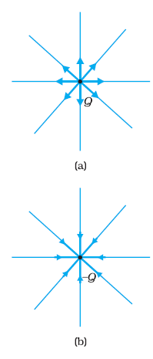
Electric Field
Due to a charge Q
Due to a charge -Q

Slide 19

Electric Field (External)
The electric field due to a charge Q at a point in space may be defined as the force that a unit positive charge would experience if placed at that point.
The charge Q, which is producing the electric field, is called a source charge and the charge q, which tests the effect of a source charge, is called a test charge .
make q negligibly small.
The force F is then negligibly small but the ratio F/q is finite and defines the electric field:

Slide 20
Problem(Force in an External Field) - NCERT
Q: An electron falls through a distance of 1.5 cm in a uniform electric field of magnitude 2.0 × 10⁴ N C^{–1}. The direction of the field is reversed keeping its magnitude unchanged and a proton falls through the same distance. Compute the time of fall in each case.

Slide 21
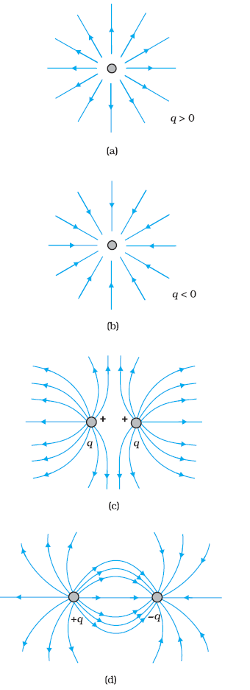
Electric Field Lines
(i) Field lines start from positive charges and end at negative charges. If there is a single charge, they may start or end at infinity.
(ii) In a charge-free region, electric field lines can be taken to be continuous curves without any breaks.
(iii) Two field lines can never cross each other. (If they did, the field at the point of intersection will not have a unique direction, which is absurd.)
(iv) Electrostatic field lines do not form any closed loops. This follows from the conservative nature of electric field

Slide 22
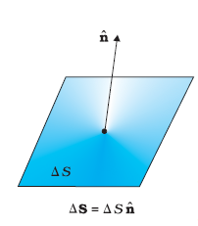
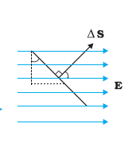
Electric Flux
Electric flux through an area element
defined by

Slide 23
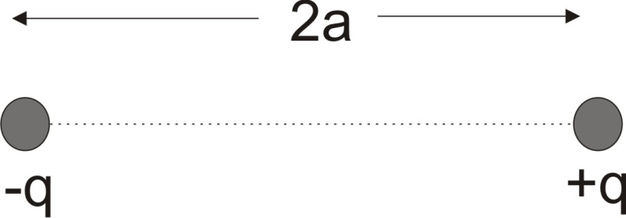
Electric Dipole
An electric dipole is a pair of equal and opposite point charges q and –q, separated by a distance 2a.

Slide 24
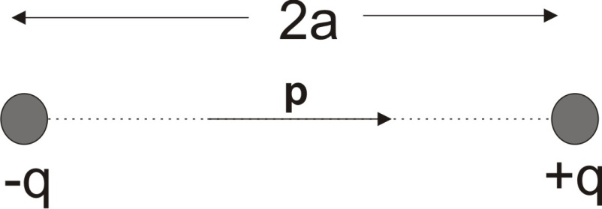
Dipole Moment
The dipole moment vector p of an electric dipole is defined by p = q × 2a

Slide 25
Field due to a Dipole
(i) For points on the axis

Slide 26
Field due to an Electric Dipole(Contd.)
(ii) For points on the equatorial plane

Slide 27
Problem (NCERT)
Q: Two charges ±10 μC are placed 5.0 mm apart. Determine the electric field at
a point P on the axis of the dipole 15 cm away from its centre O on the side of the positive charge, as shown in Fig.(a) and
a point Q, 15 cm away from O on a line passing through O and normal to the axis of the dipole, as shown in Fig. (b).

Slide 28
DIPOLE IN A UNIFORM EXTERNAL FIELD
Magnitude of torque = q E × 2 a sinθ = 2 q a E sin θ

Slide 29
CONTINUOUS CHARGE DISTRIBUTION
The linear charge density λ of a wire is defined by λ=
We then define a surface charge density σ at the area element by σ=
The volume charge density ρ=

Slide 30
GAUSS’S LAW
The flux through an area element is
The total flux equals

